Slide 1
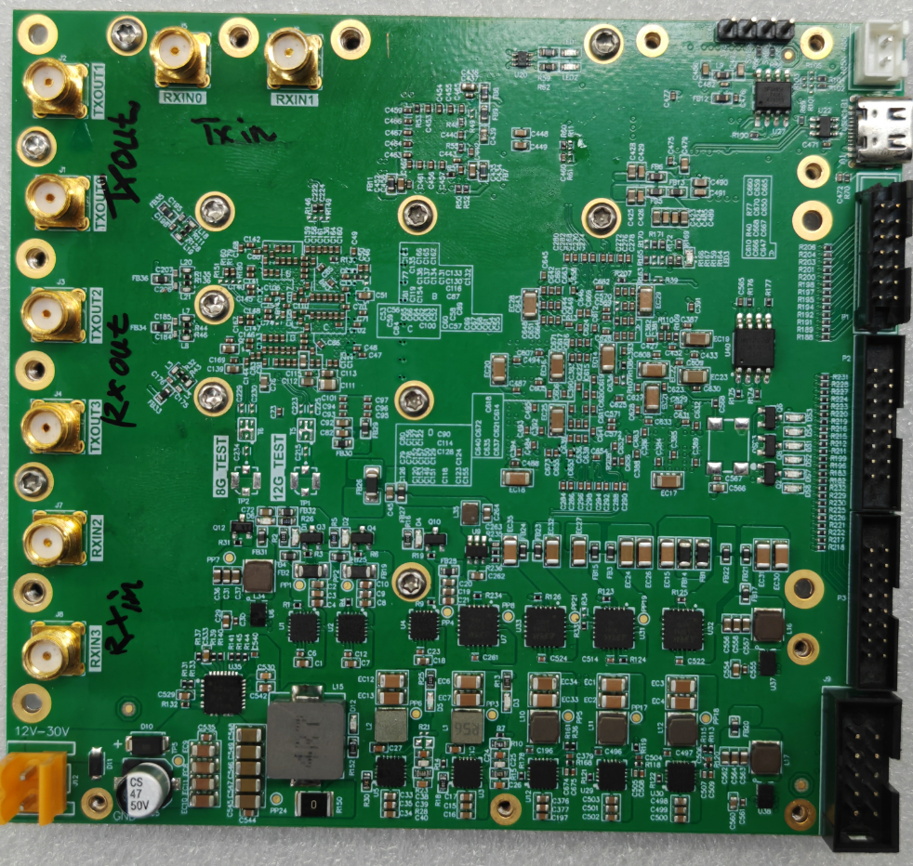
SDR core PCBA board features:
1. SDR platform consisting of FPGA and RF direct acquisition transceiver.
2. 100K logic resources, 424 18*18 multipliers, resource-rich FPGA.
3. 4T4R 14-bit ADC and DAC RF direct sampling transceiver.
4. Working frequency: 400MHz~8000MHz.
5. Large scanning bandwidth, currently supports the maximum sampling bandwidth of 160MHz per channel; It can be designed to support a maximum sampling bandwidth of 800MHz per channel.
6. 32 bit high-precision frequency control.
7. Each RF channel, input and output have DSA built-in, and the attenuation range is 0~31dB.
8. No LO leakage and I/Q imbalance.
9. Application: public network 3G, 4G, 5G, TDD and FDD mobile communications, signal monitoring systems, other radio radar and detection, private network communication systems, etc.

Slide 2
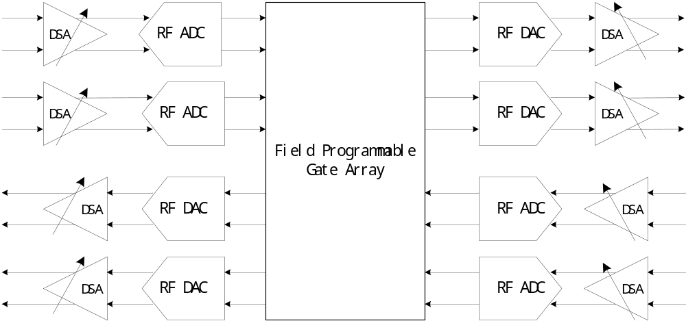
Card Diagram①

Slide 3
Card Diagram②

Slide 4
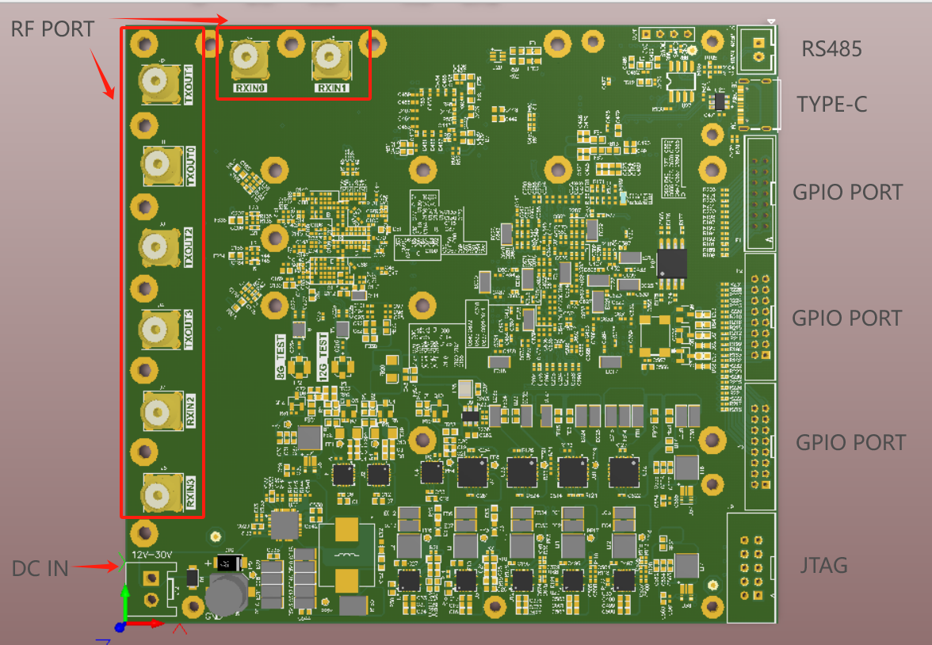
Card Diagram③

Slide 5
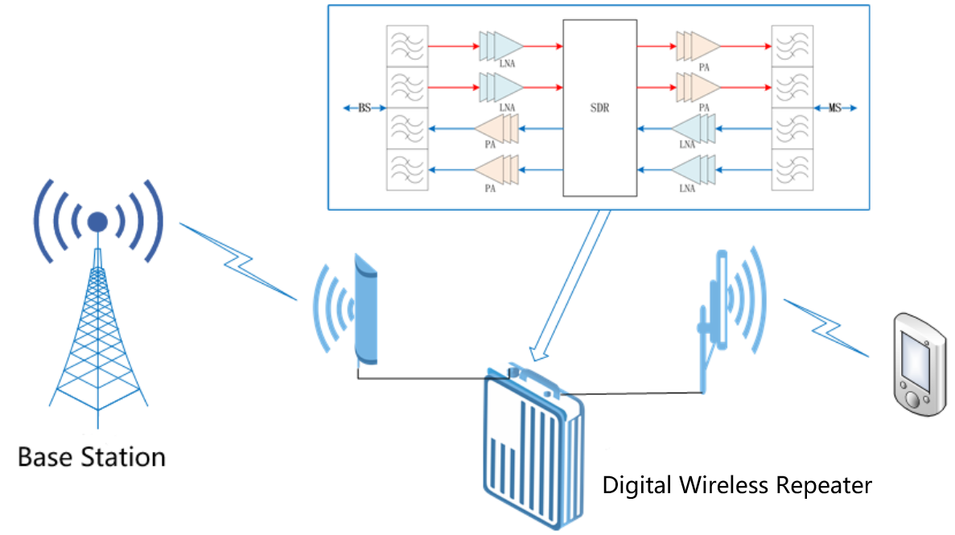
Typical Application

